Slide 1
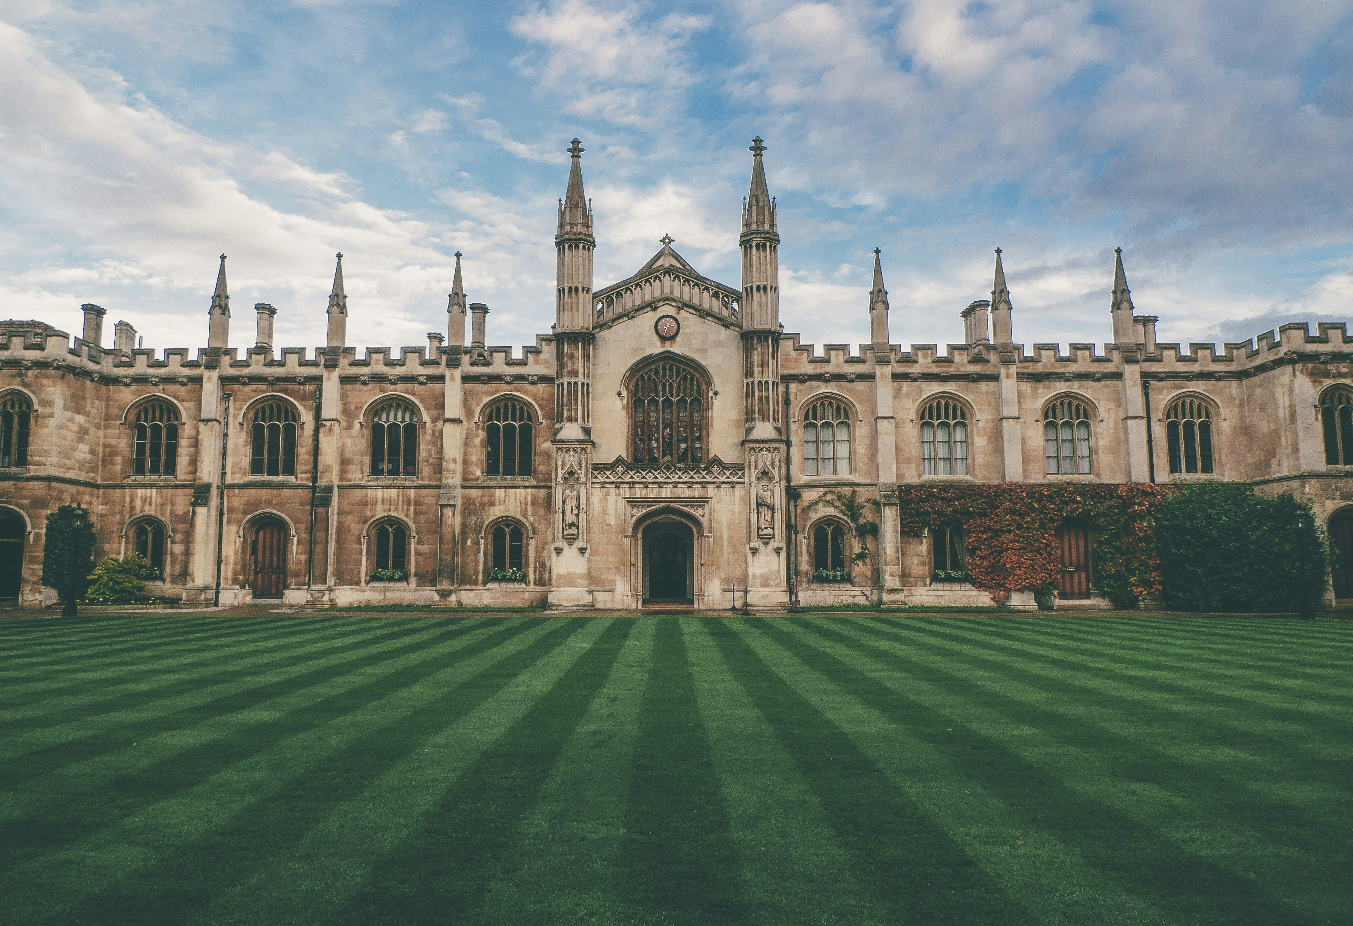
Analysis of World University Rankings

Slide 2
Findings in the dataset:
Missing Values – 8
Rankings Range – 1:12721
Source – www.Kaggle.com
Dataset – World University Rankings
Number of Ranked Universities in World – 12713

Slide 3
USA secured Top 10 rankings in the world

Slide 4
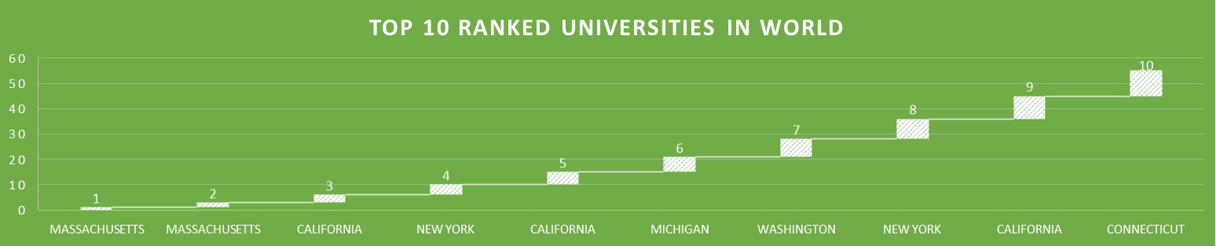
Massachusetts Institute of Technology in USA secured the world’s first ranked University

Slide 5
Massachusetts Institute of Technology in USA secured the world’s first ranked University

Slide 6
Findings in the dataset:
Number of Ranked Universities in India– 875
Tamil Nadu’s 53 listed in the dataset and is in 7th highest count of universities in Indian states listed at dataset

Slide 7
Uttar Pradesh has got the highest count of ranked universities in Indian states listed at dataset -79

Slide 8
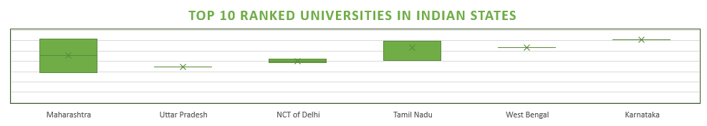
Indian Institute of Technology Bombay in Maharashtra has the highest Indian states rank of 575 in the world

Slide 9
Number of Ranked Universities in Tamilnadu – 53

Slide 10
Indian Institute of Technology Madras has got the highest rank of 815 in Tamil Nadu listed at dataset

Slide 11
Thank You

